Slide 1
Backup slides

Slide 2








Database Applications are everywhere…
Notes:
For those applications, performance is critical.

Slide 3
Rewritten Query
WITH (
SELECT n
FROM db.nations AS n,
session.selected_nations AS s
WHERE s.nation_ref = n.nation_key
AND s.selected = true
) AS temp_nations
SELECT l.nation_key AS nation_key,
l.nation_name AS nation_name,
r.N AS aggregates
FROM temp_nations AS l
LEFT OUTER JOIN (
SELECT nation_key,
X AS N
FROM Y AS r
ON l.nation_key = r.nid;
X = (SELECT g.x.order_year AS order_year,
g.x.sum_price AS sum_price
FROM group AS g
ORDER BY g.x.sum_price DESC
LIMIT 3)
Y = (
SELECT nation_key,
order_year,
sum(o.total_price) AS sum_price
FROM Orders AS o,
Customers AS c,
temp_nations AS n
WHERE o.cust_ref = c.cust_key and
c.nation_ref = n.nation_key
GROUP BY n.nation_key,
o.order_year
) AS x
GROUP BY x.nation_key
) AS r

Slide 4
Forward Plan Execution
TO BE DETERMINED

Slide 5


Application/Database Interaction
Queries sent synchronously through network
Too many requests
Query is optimized into the most efficient plan available and processed
Imperative program logic
executed
Poor performance
Results sent back to application for processing
Notes:
Maybe keep application server around to make sure people are not lost

Slide 6
Example
int sum = 0;
List categories = new ArrayList();
ResultSet rs = execute("SELECT * FROM categories");
while (rs.next()) categories.add(rs.getInt("id"));
while (!categoryList.isEmpty()) {
int category = categoryList.removeFirst();
rs = execute("select count(partkey) from part p" +
"where p.category=" + category);
int count = rs.getInt("count");
sum += count;
}
For each category :
network round trip
complete query execution (may include disk access)
Tuple-at-a-time Strategy
Notes:
duplicate work

Slide 7
Optimized Example
int sum = 0;
List categoryCounts = new ArrayList();
ResultSet rs = execute(
"SELECT c.id, count(partkey)
FROM category c LEFT OUTER JOIN part p
ON c.id = p.category
GROUP BY c.id");
while (!CategoryCounts.isEmpty()) {
count = CategoryCounts.removeFirst();
sum += count;
}
Benefits :
Avoids round-trips
gives extra optimization opportunities to the query compiler
computes all counts at once
Set-at-a-time Strategy

Slide 8
30,000 feet comparison
Tuple-at-time :
Cons :
Subquery is executed for every qualifying customer
Performs a network round trip at every iteration
Set-at-a-time :
Pros :
Computes all of the orders counts at once.
Network round-trip happens only once
Pros :
Simple to express for a user (similar to function invocation)
Applicable to any kind of nested query formulation.
Cons :
Query rewriting is complex and error-prone
Restricted to certain classes of programs.
Rewrite tuple-at-a-time programs into set-at-a-time programs

Slide 9
Problem
Queries sent synchronously through network
Query is optimized into the most efficient plan available and processed
Imperative program logic
executed
Language and Query compiler are unaware of each other
Application-Centric Optimizations
Language Compiler
Results sent back to application for processing
Database-Centric Optimizations
Query Compiler

Slide 10
Solution
Queries sent synchronously through network
Holistic Optimization
Optimize data access across application and database server
Query is optimized into the most efficient plan available and processed
Imperative program logic
executed
Language and Query compiler are unaware of each other
Application-Centric Optimizations
Language Compiler
Results sent back to application for processing
Database-Centric Optimizations
Query Compiler

Slide 11
Holistic Optimization
Static Optimization : rewrite application programs to use more efficient data access strategies
Example : rewrite tuple-at-a-time programs into equivalent set-at-a-time programs
Dynamic Optimization : TBD
We focus on static optimization in this talk

Slide 12
Outline
Motivation
Background
Static Analysis
Dynamic Analysis
Declarative specification
Conclusion

Slide 13
Query Decorrelation
Query 1 :
SELECT C.name
FROM Customer C
WHERE 3 > (
SELECT COUNT(*)
FROM Orders O
WHERE O.custkey = C.custkey
)
C.custkey refers to the Customers relation from the outer query, we call it an outer reference.
Customers who have placed less than 3 orders with the company

Slide 14
Tuple-at-a-time execution
[Selinger & al 1979]
Execute subquery for every customer key
SELECT C.name
FROM Customer C
WHERE 3 > (
SELECT COUNT(*)
FROM Orders O
WHERE O.custkey = C.custkey
)
SELECT COUNT(*)
FROM Orders O
WHERE O.custkey = 1
...
SELECT COUNT(*)
FROM Orders O
WHERE O.custkey = N
Customers who have placed less than 3 orders with the company

Slide 15
Set-at-a-time execution (Kim’s method)
[Kim & al 1982]
Compute the set of order count for every customer and join that set with the original table
SELECT C.name
FROM Customer C, Temp T
WHERE C.custkey = T.custkey
AND 3 > Tmp.cnt
CREATE TEMP TABLE Temp AS (
SELECT O.custkey AS custkey,
Count(*) AS cnt
FROM Orders O
GROUP BY O.custkey
)
Customers who have placed less than 3 orders with the company

Slide 16
Query Decorrelation
Query Decorrelation
Data Dependency Graphs
Hoare Logic?

Slide 17
Backup Slides

Slide 18
Per
Queries are interspersed within application program
Queries are submitted at run-time to the QP

Slide 19
Developer Choices
Language Choice : SQL vs Java/Ruby
Location Choice : App server vs Database

Slide 20
ORMs : the classical solution
ORM example

Slide 21
Impedance Mismatch
class Customers {
....
}
custkey | name
1 | Alice
2 | Bob
3 | Charles
Logical
Customers
Physical
Application Server
Database

Slide 22
Impedance Mismatch
Complex nested objects and data structures
Procedural languages
Data in process memory, volatile
Application Server
Flat Relations
Declarative Queries
Data persisted on disk
Database Server
Data Model
Language Paradigm
Data Duplication and lifecycle
Environment
Application Program
Relational Database

Slide 23
ORMs to the rescue
Hibernate ORM
List<User> getRoleUser() {
List<User> listUsers = new ArrayList<>();
List<User> users = this.userDao.getUsers();
// Query : SELECT * FROM users
List<Role> roles = this.roleDao.getRoles();
// Query > SELECT * FROM roles
for (User u : users) {
for (Roles r : roles) {
if (u.roleId().equals(r.roleId())) {
U userok = u;
listUsers.add(userok);
}
}
}
}
Location Transparency
Fetching too much data
Single Language Access
Slow algorithm
Poor Performance

Slide 24
ORMs to the rescue
Optimized SQL Query
List<User> getRoleUser() {
List<User> listUsers = db.executeQuery(
"SELECT u" +
"FROM users u , roles r" +
"WHERE u.roleId == r.roleId" +
"ORDER BY u.roleId, r.roleId");
return listUsers;
}
Location Transparency
Single Language Access
Poor Performance

Slide 25
ORMs to the rescue
List<User> getEnrolledStudents() {
List<Student> enrolledStudents = new ArrayList<>();
List<Student> students = this.studentDao.getUsers();
// Query : SELECT * FROM users
for (User u : users) {
List<Enrollment> enrolls =
this.enrollDao.getEnrollments();
// Query > SELECT * FROM roles
for (Enrollment e : enrolls) {
if (s.studentId().equals(r.roleId())) {
enrolledStudents.add(s);
}
}
}
return enrolledStudents;
}
Fetching too much data
Too many queries
Slow algorithm

Slide 26
Tuple-at-a-time execution
[Selinger & al 1979]
Execute subquery for every customer key
SELECT s
FROM Students s
WHERE s.sid IN (
SELECT c.sid
FROM Enrol
)
SELECT COUNT(*)
FROM Orders O
WHERE O.custkey = 1
...
SELECT COUNT(*)
FROM Orders O
WHERE O.custkey = N

Slide 27
Set-at-a-time execution (Kim’s method)
[Kim & al 1982]
Compute the set of order count for every customer and join that set with the original table
SELECT C.name
FROM Customer C, Temp T
WHERE C.custkey = T.custkey
AND 3 > Tmp.cnt
CREATE TEMP TABLE Temp AS (
SELECT O.custkey AS custkey,
Count(*) AS cnt
FROM Orders O
GROUP BY O.custkey
)
Customers who have placed less than 3 orders with the company

Slide 28
With application program
[Selinger & al 1979]
Tuple at a time
Set at a time

Slide 29
… but suffer from poor performance
Amazon found every 100 ms of latency cost them 1% in sales

Slide 30
Compute verification conditions

Slide 31
Generate space of post-conditions

Slide 32
Translate to SQL

Slide 33
Outline
Motivation
Query Synthesis
Rewriting into batch queries
Query language integration
Declarative Middleware
Future Directions

Slide 34
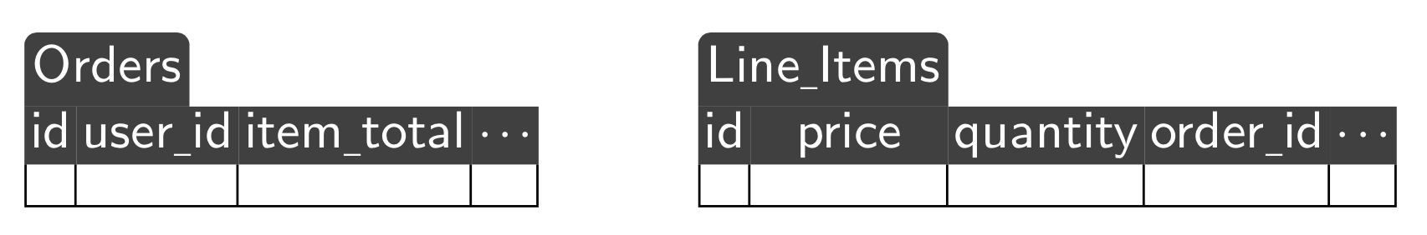
Deep Query Embedding
What would be the cost of granting a discount on the open orders of all high-volume (more than 10 open orders) customers?
Schema

Slide 35
Deep Query Embedding
# Grant a 20% discount…
discount = 20.0/100
# … to customers with more than 10 open orders
high_vol = 10
high_vols = Order.group("user_id")
.having("[COUNT(user_id) >= ?", high_vol])
.select("user_id")
open_orders = Order.where(
"user_id IN (:tc) AND state = :s",
{ tc: high_vols.map(&:user_id),
s: "0" }])
items = open_orders.includes(
:Line_Item).map(&:line_items).flatten
cost = items.sum {|i| i.price * i.quantity} * discount
SELECT user_id
FROM Orders
GROUP BY user_id
HAVING COUNT(user_id) >= 10;
SELECT *
FROM Line_Items
WHERE order IN (2,3,...,65000);
SELECT *
FROM Orders
WHERE user_id IN (4,8,...,1498,1499)
AND state = '0';
Size of query depends on size of database
Intermediate results are materialized
ActiveRecord (Ruby on Rails ORM)
Code Generated By Rails

Slide 36
Deep Query Embedding
# grant a 20% discount ...
discount = 20.0/100
# ... to customers with more than 10 open orders
high_vol = 10
high_vols = Order.group_by(&:user_id)
.select {|u,os| os.length >= high_vol}
open_orders = high_vols.map {|u,os| os.select
{|o| o.state == "0"}}.flatten
items = open_orders.map {|o| line_item.in_order(o)}.flatten
cost = items.sum {|i| i.price * i.quantity} * discount
SELECT SUM(li.price * li.quantity) * 0.2
FROM (
SELECT o2.user_id, COUNT(*) AS cnt
FROM Orders AS o2
GROUP BY o2.user_id
) AS oc,
Orders AS o1,
Line_Items AS li
WHERE o1.id = li.order_id
AND o1.state = 'O'
AND oc.user_id = o1.user_id
AND oc.cnt > 10
Switch (Ruby DSL)
Code Generated by Switch

Slide 37
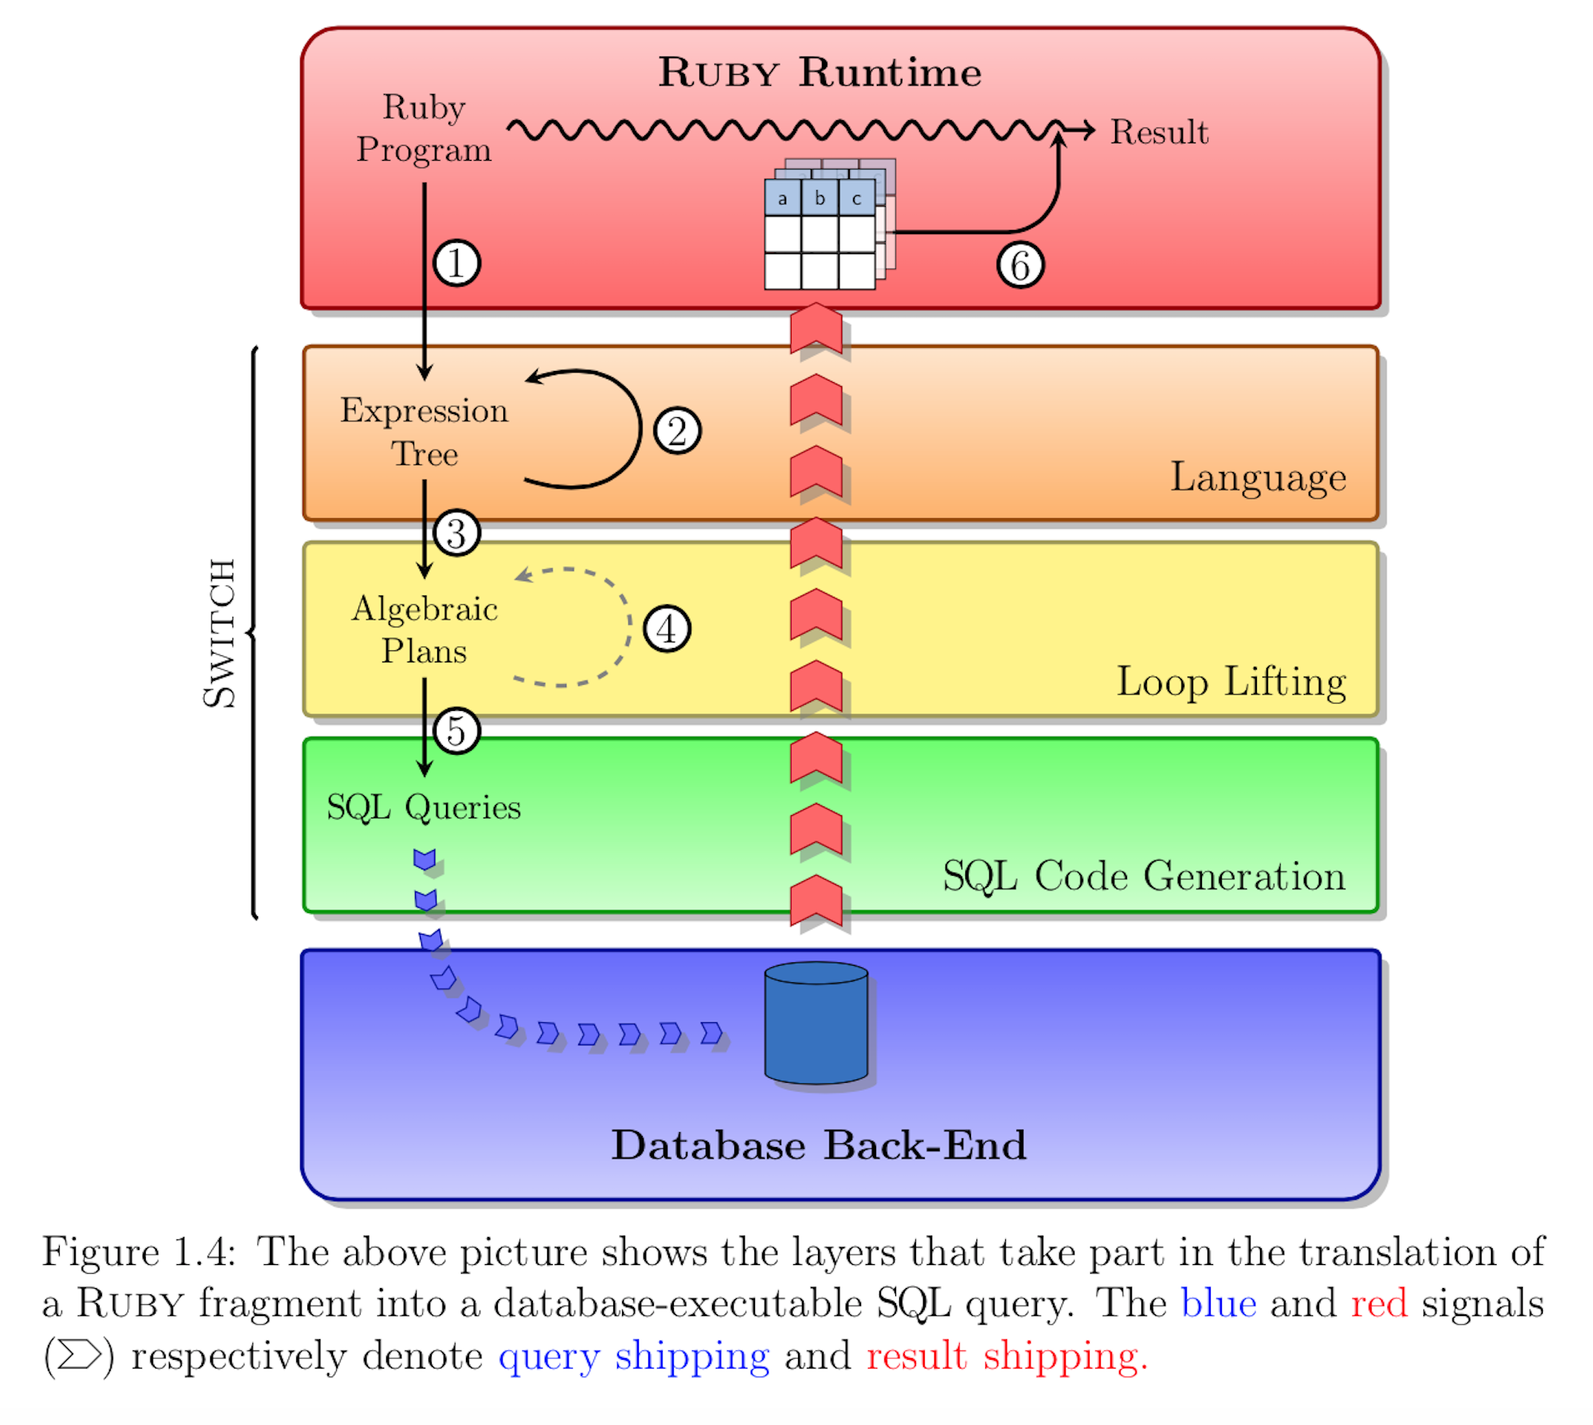
Switch Architecture
1
Derive expression tree representing source ruby program
2
Apply type-sensitive rewrites
3
Translate trees into algebraic plans
4
Apply optimizations to algebraic plans
5
Translate algebraic plans to SQL queries
6
Materialize results in Ruby heap

Slide 38
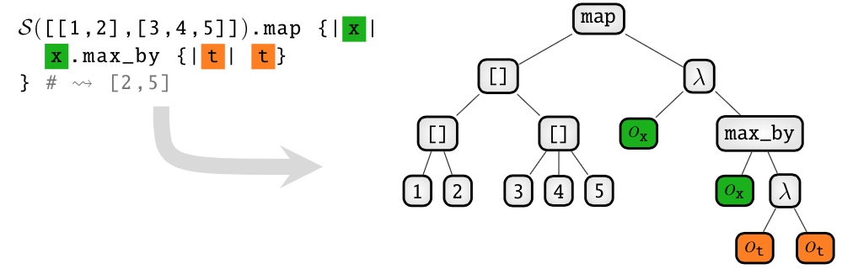
Derive Expression Tree [not ready]

Slide 39
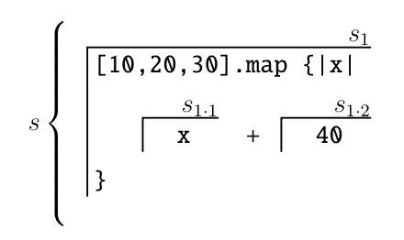
Loop Lifting [not ready]

Slide 40
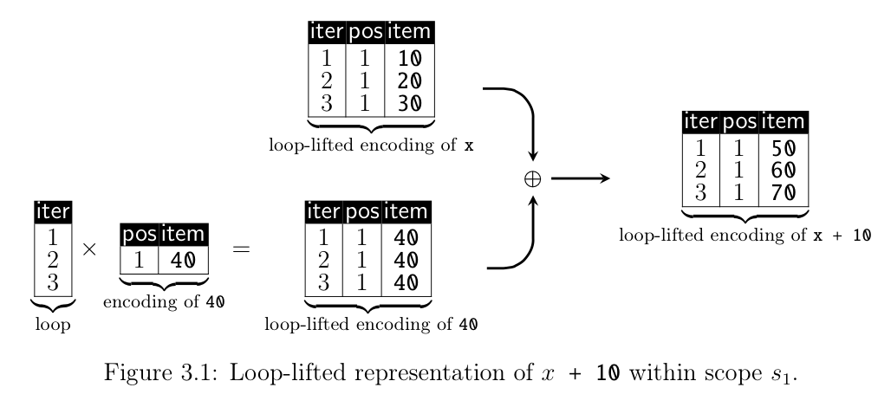
Loop Lifting [not ready]

Slide 41
Generating a relational plan
NOT READY

Slide 42
Generating SQL
NOT READY

Slide 43
Pros and cons

Slide 44
Problem
Too many queries
Data is processed with suboptimal algorithms
Queries sent synchronously through network
Query is optimized into the most efficient plan available and processed
Imperative program logic
executed
Language and Query compiler are unaware of each other
Application-Centric Optimizations
Language Compiler
Results sent back to application for processing
Database-Centric Optimizations
Query Compiler

Slide 45
Solution
Queries sent synchronously through network
Holistic Optimization
Optimize data access across application and database server
Query is optimized into the most efficient plan available and processed
Imperative program logic
executed
Language and Query compiler are unaware of each other
Application-Centric Optimizations
Language Compiler
Results sent back to application for processing
Database-Centric Optimizations
Query Compiler

